Slide 1

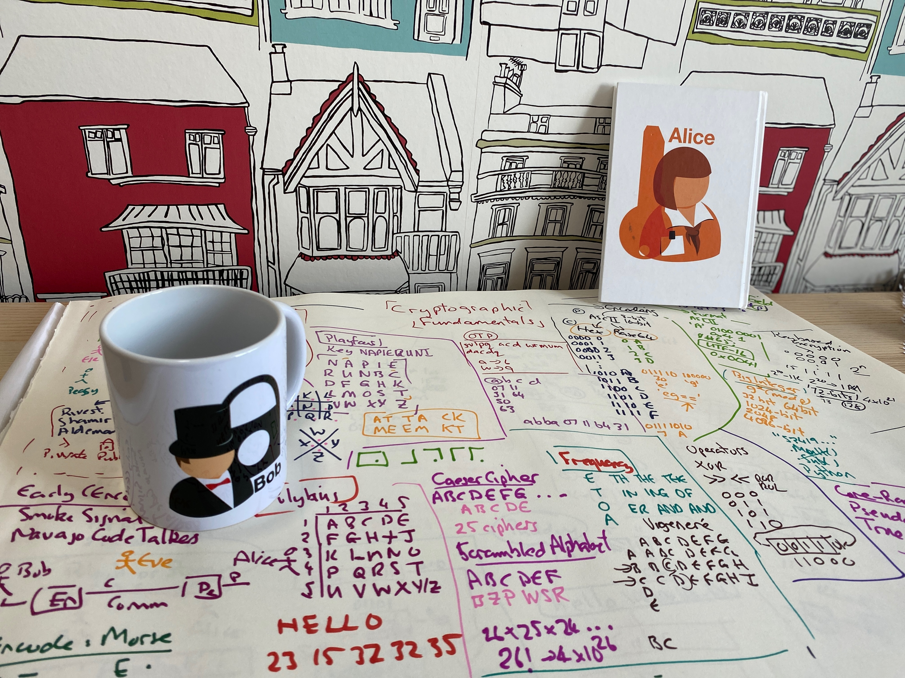
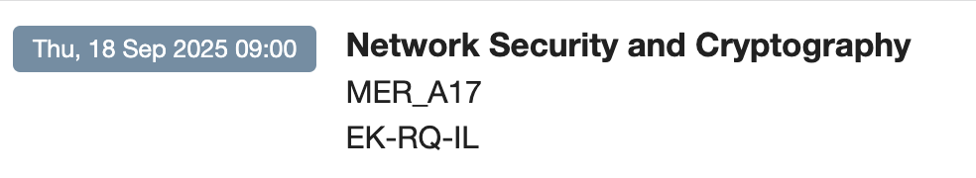


Introduction
Module Overview Timetable vSoC 2/AWS Prof Bill Buchanan OBE, FRSE https://asecuritysite.com

Slide 2
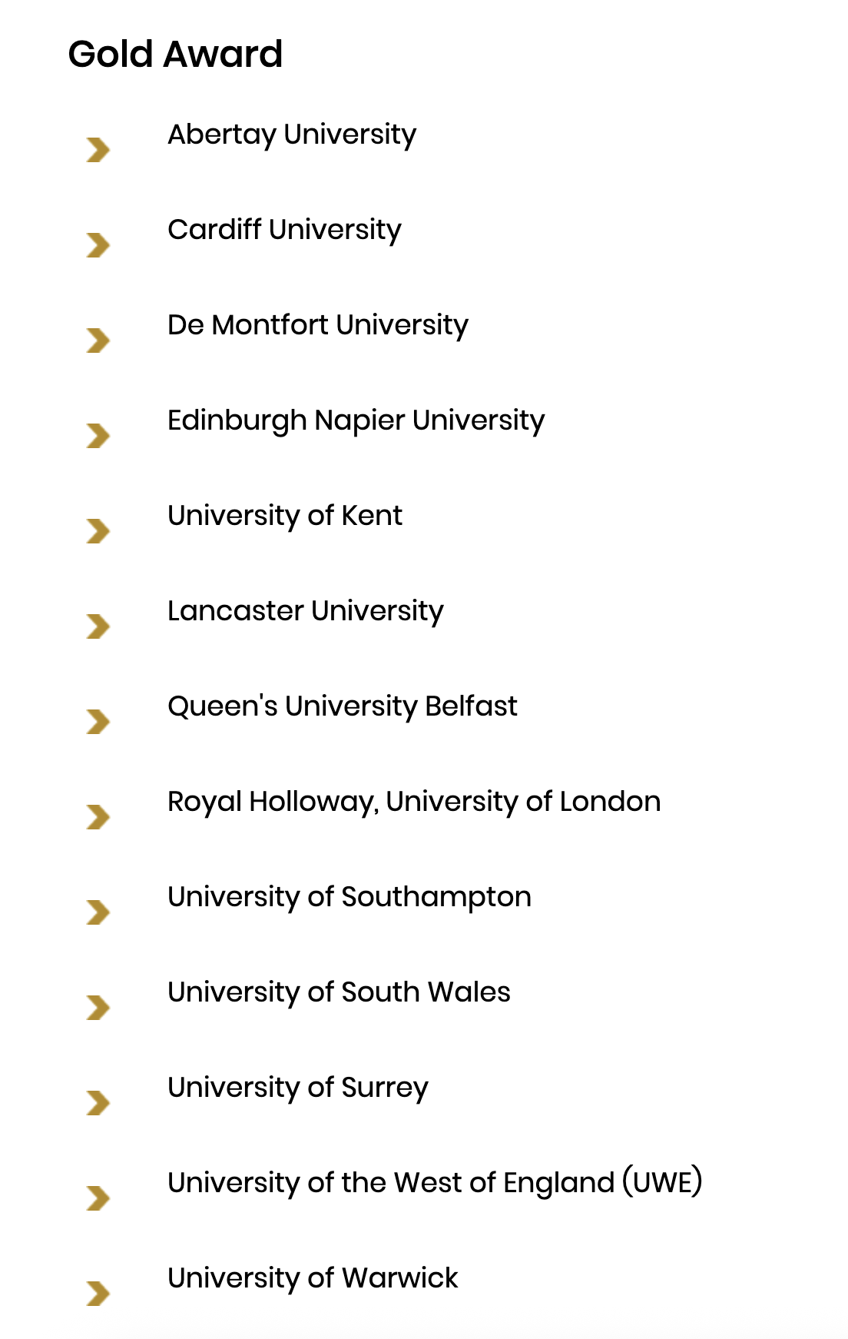
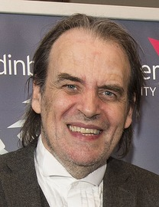
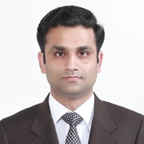
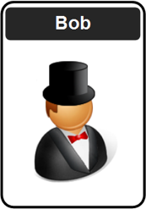



Professor Bill Buchanan OBE. Twitter: @billatnapier Web: asecuritysite.com
Sana Ullah Jan

Slide 3
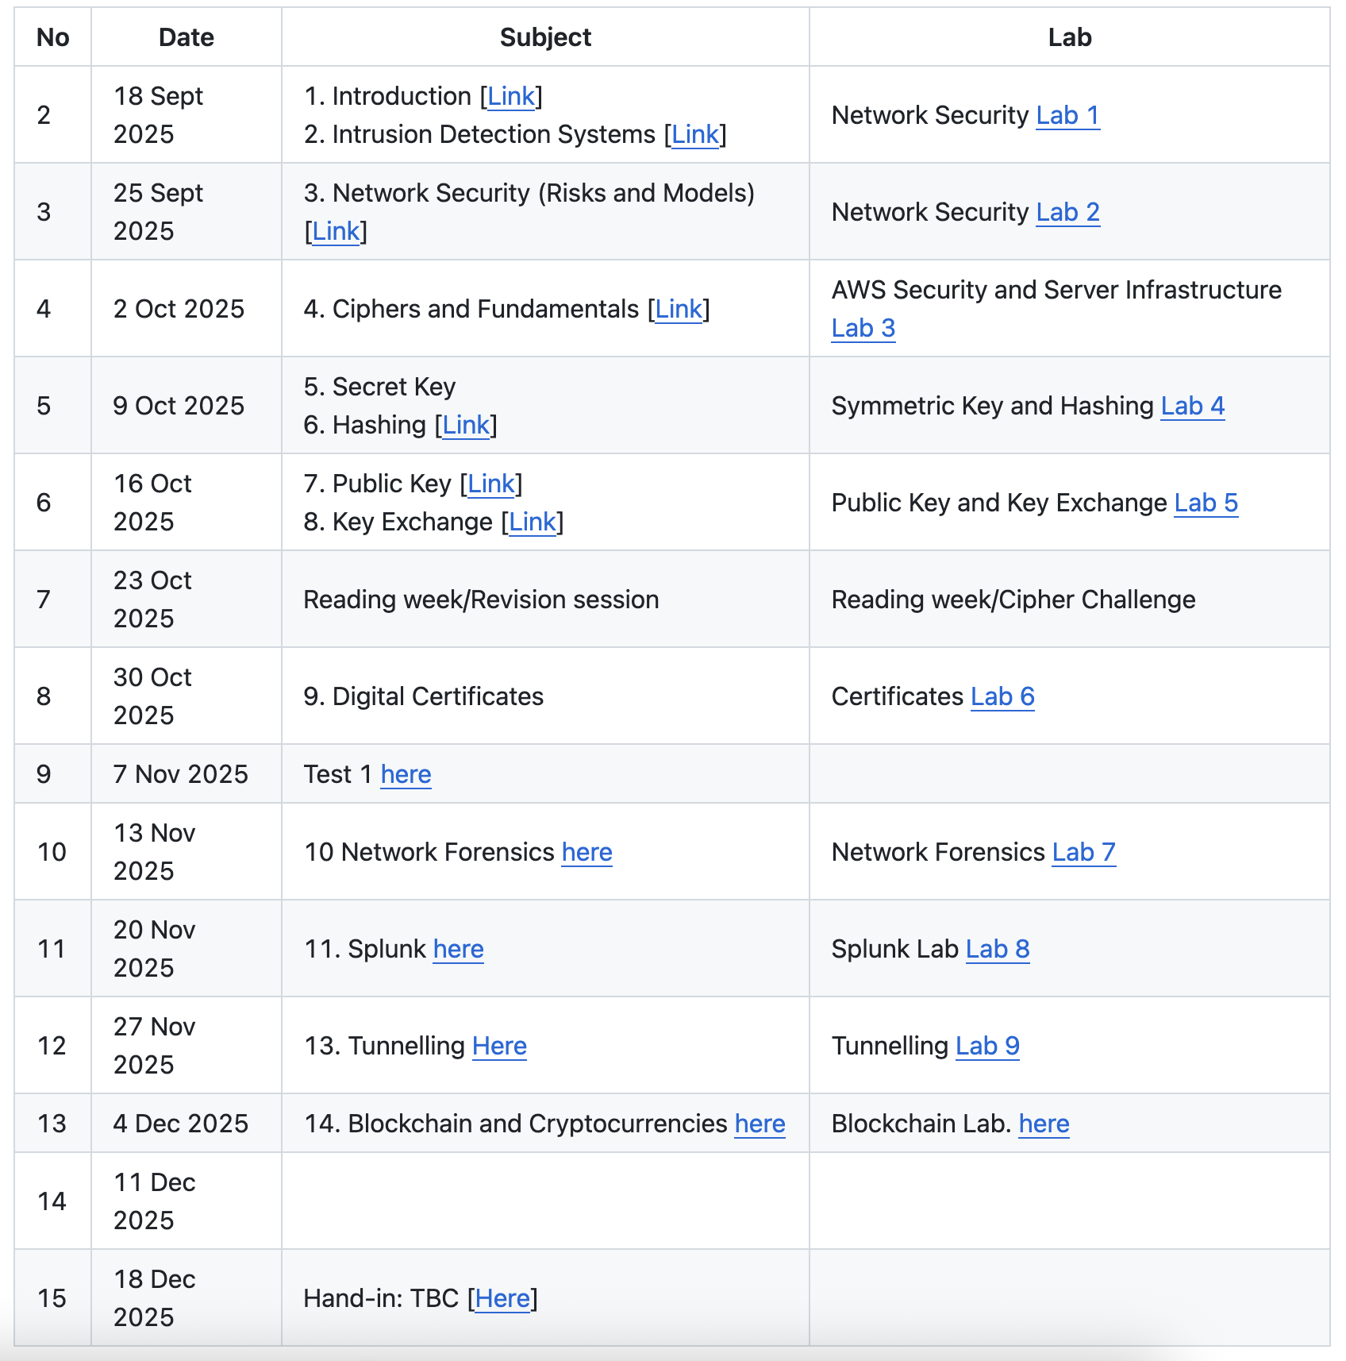
git clone https://github.com/billbuchanan/csn09112

Slide 4
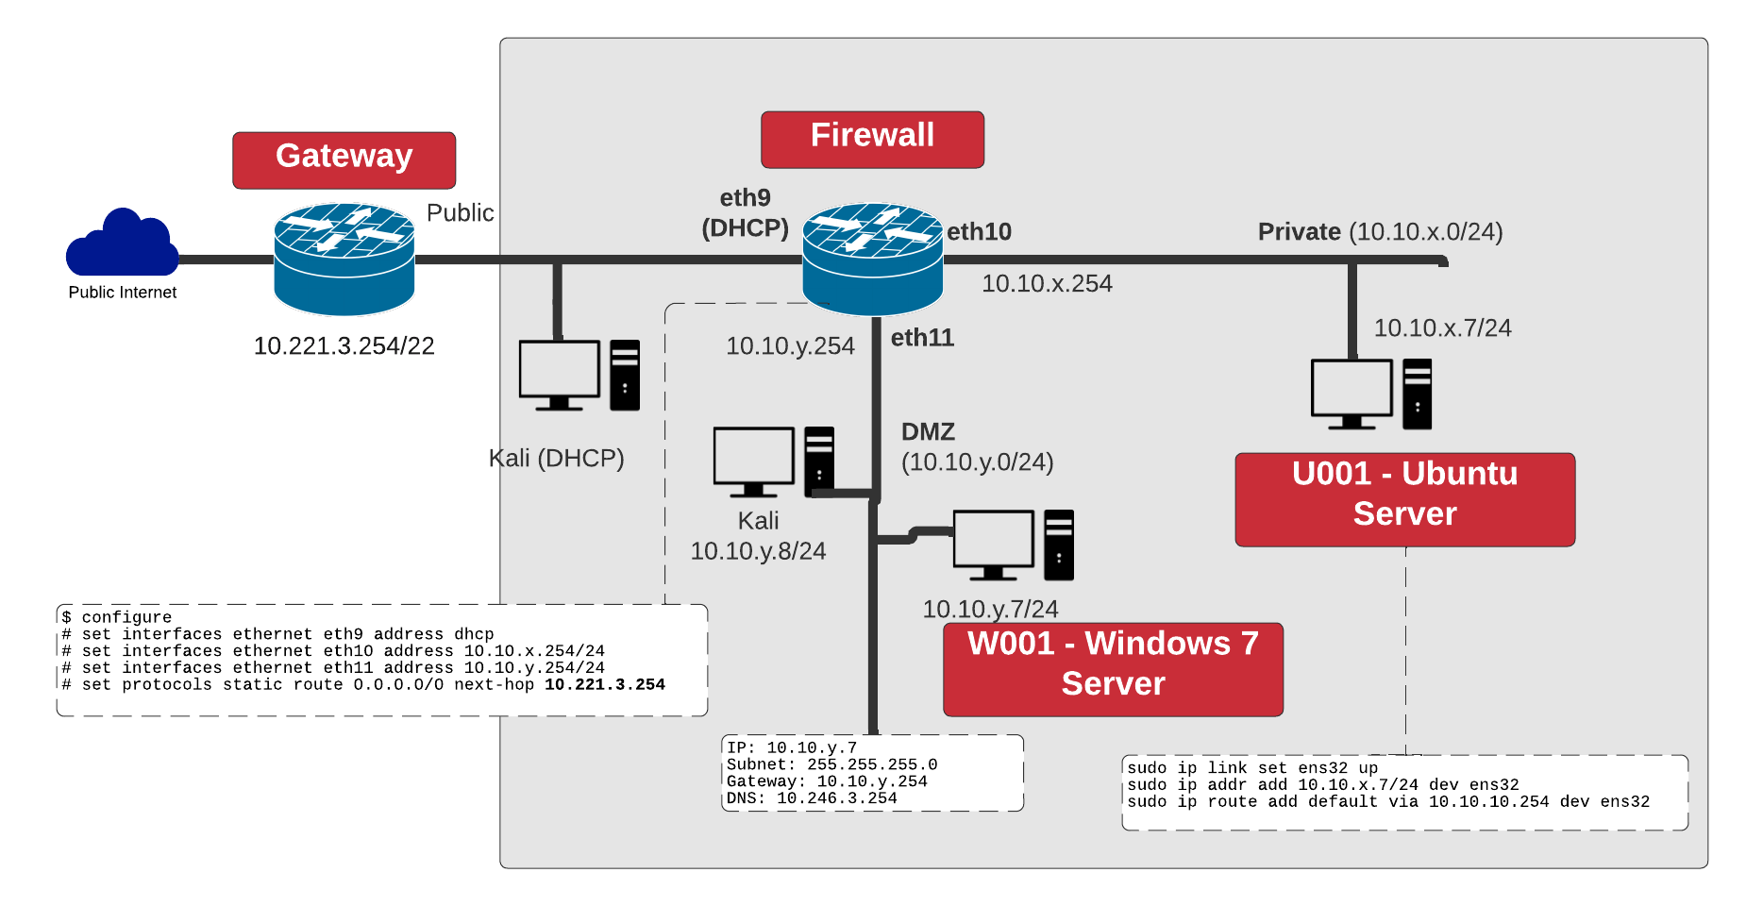

Slide 5
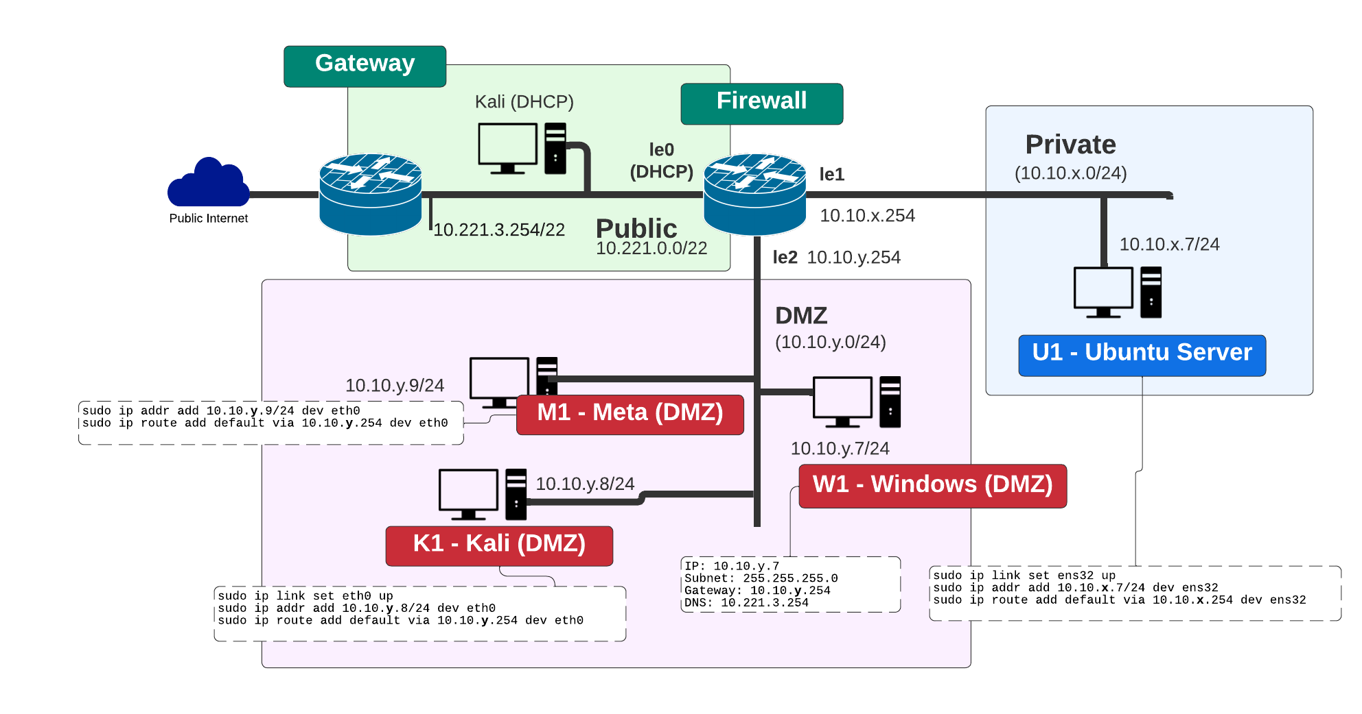

Slide 6
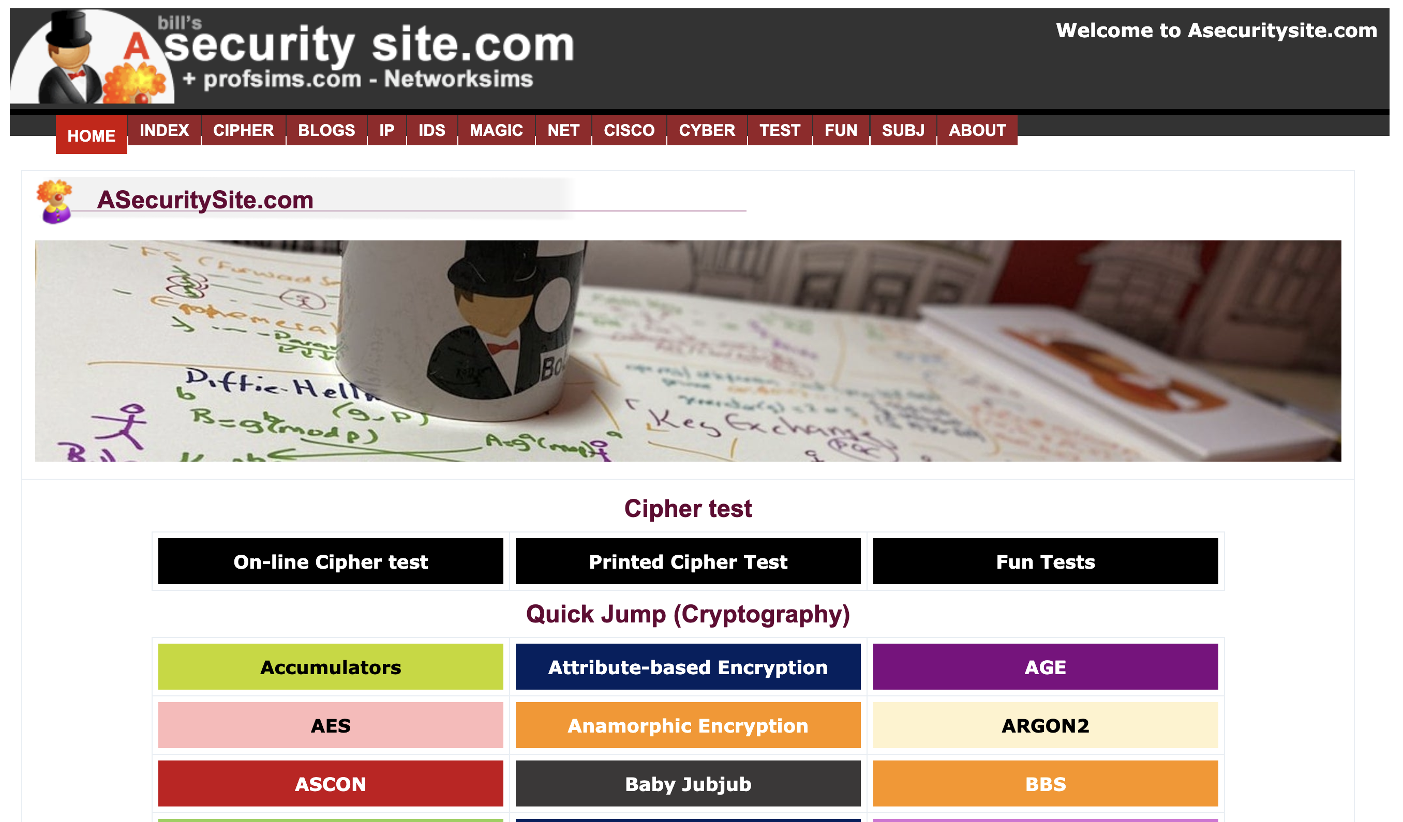

Slide 7
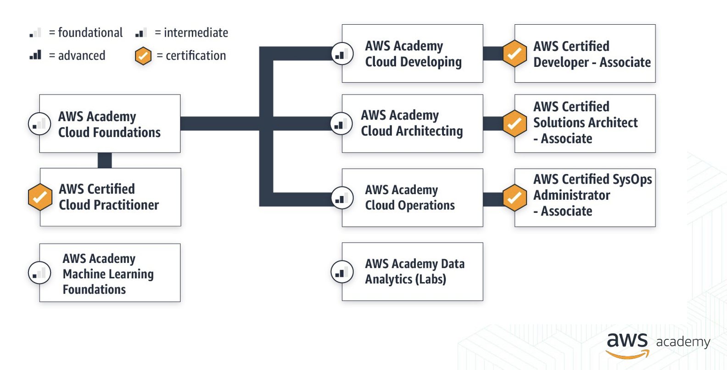

Slide 8
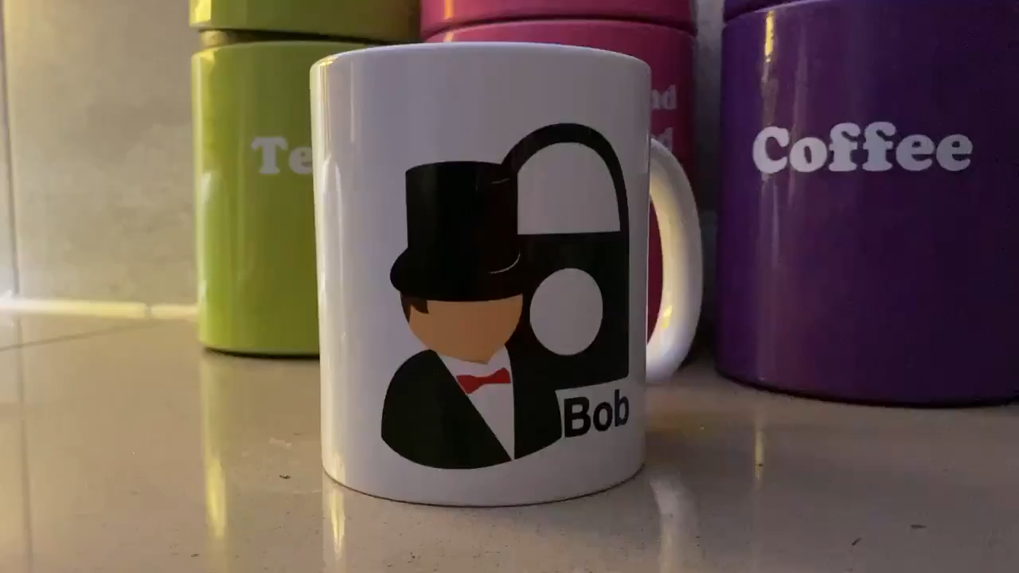

Slide 9
Introduction
Module Overview Timetable vSoC 2/AWS Prof Bill Buchanan OBE, FRSE https://asecuritysite.com

